Slide 1
Ending Hunger Together:
Food Banks and Area Agencies on Aging
W. Mark Clark, MSW
President & CEO

Slide 2
Number of Hungry Seniors Doubled Since 2001. It’s Going to Get Worse!

Slide 3
Aging in America
10,000 Baby Boomers are turning 65 everyday
2/3 of all people 65+ in the history of the world are alive today
44.7 million people were 65 on July 1, 2013 – 14.5% of the population
2056 – 65+ will outnumber those younger than 18
$35,611 median household income of householders 65+ 2013
9.5% percentage of 65+ (4.2 million) in poverty 2013
$170,516 median net worth 65+HH (2011) down from $203,015 2011
58% - 65+ Married; 11.3% widowed (2014)

Slide 4
The Silver Tsunami in AZ
2015 | 60-64 | 65-69 | 70-74 | 75-79 | 80-84 | 85+ | Total 60+ | Total Pop
Female | 200,287 | 184,736 | 142,554 | 101,597 | 70,934 | 75,749 | 775,857 | 3,402,491
Male | 178,805 | 165,953 | 124,562 | 88,741 | 59,265 | 46,794 | 664,119 | 3,375,044
Total | 379,091 | 350,689 | 267,116 | 190,338 | 130,200 | 122,543 | 1,439,977 | 6,777,534
2035
Female | 258,225 | 253,770 | 256,995 | 222,979 | 163,740 | 172,996 | 1,328,703 | 4,761,755
Male | 236,399 | 236,785 | 237,171 | 194,930 | 133,208 | 124,966 | 1,163,459 | 4,778,758
Total | 494,624 | 490,556 | 494,165 | 417,908 | 296,948 | 297,962 | 2,492,163 | 9,540,513

Slide 5
Silver Tsunami in Pima County
2015 | 60-64 | 65-69 | 70-74 | 75-79 | 80-84 | 85+ | Total 60+ | Total Pop
Female | 34,057 | 30,745 | 23,555 | 17,025 | 12,377 | 14,194 | 131,953 | 518,708
Male | 30,014 | 27,362 | 19,979 | 14,104 | 10,099 | 8,610 | 110,168 | 503,371
Total | 64,072 | 58,107 | 43,534 | 31,128 | 22,476 | 22,804 | 242,120 | 1,022,079
2035
Female | 33,840 | 34,178 | 37,761 | 35,146 | 27,015 | 28,253 | 196,193 | 662,258
Male | 31,461 | 31,377 | 33,633 | 29,080 | 21,255 | 19,261 | 166,066 | 649,843
Total | 65,300 | 65,555 | 71,394 | 64,226 | 48,270 | 47,514 | 362,259 | 1,312,101

Slide 6
Informal (Family) Caregiving
42 million family caregivers – 80-90 of care is estimated informal
The value of family caregiving estimates range from $39b to $450b
Caregiver Support Ratio: today 7 potential caregivers (45-65) per 80+ In 2026 – 4 and in 2050 – 3
91.5% 65+ have one chronic health condition; 76.6 have 2 or more (2008 estimate AHRQ)
In 2002 – 37 visits to 14 doctors who write 50 prescriptions annually (Partnership for Success)

Slide 7
Older American Act Nutrition Assistance

Slide 8
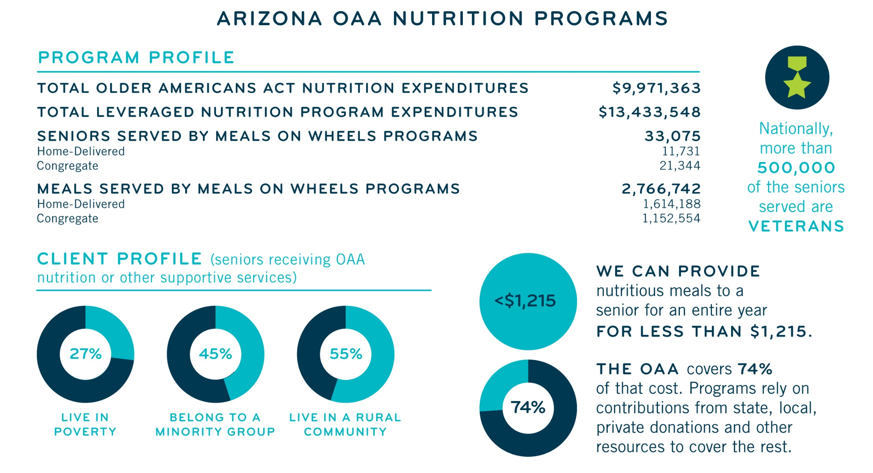
Arizona and the OAA

Slide 9
Supporting Seniors in their Homes

Slide 10
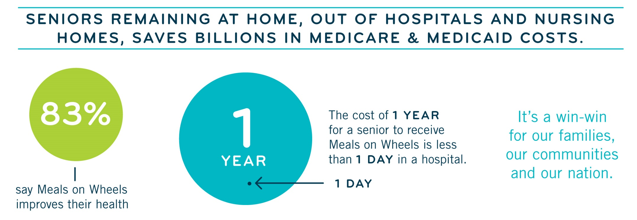
Seniors Remaining at Home

Slide 11
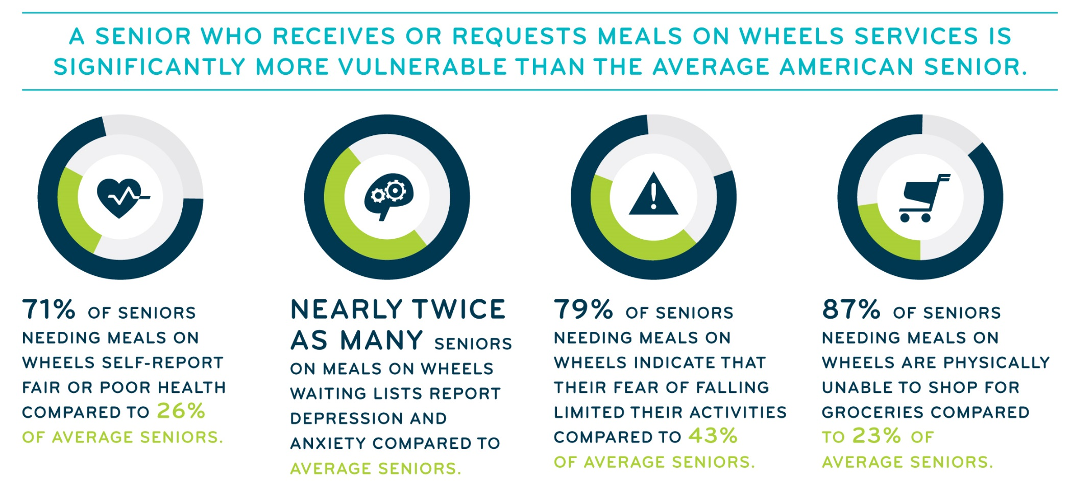
Seniors and Meals

Slide 12
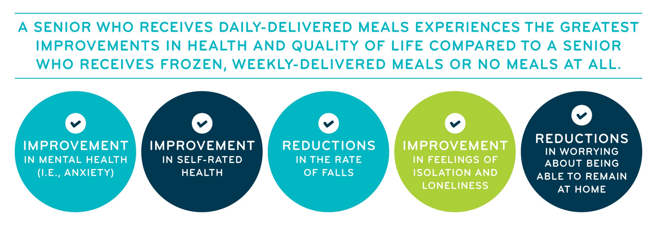
Seniors and Meals

Slide 13
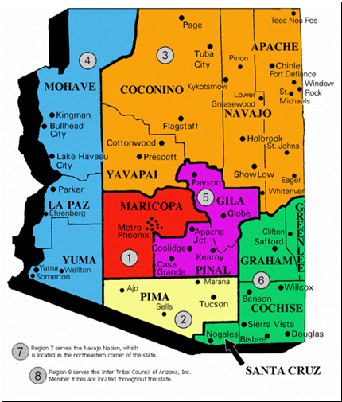
AZ Area Agencies

Slide 14
AAAs In Arizona
REGION I (Maricopa County) Mary Lynn Kasunic President & CEO/Area Agency Director Area Agency on Aging, Region One, Inc. 1366 E. Thomas Road, Suite 108 Phoenix, Arizona 85014 kasunic@msn.com 602.264.2255 602.214.7740 602.230.9132 Fax | REGION V (Pinal & Gila Counties) Olivia Guerrero, President/CEO Area Agency on Aging, Region V Pinal-Gila Council for Senior Citizens 8969 W. McCartney Rd. Casa Grande, Arizona 85194 oliviag@pgcsc.org 520.836.2758 520.421.2033 Fax | REGION III (Apache, Coconino, Navajo & Yavapai Counties) Mary Beals Luedtka, Director Area Agency on Aging, Region III Northern AZ Council of Governments 43 S San Francisco St Flagstaff, Arizona 86001 mluedtka@nacog.org 877.521.3500 928.213.5226 (Mary’s Direct Line) 928.214.7235 Fax
REGION II (Pima County) W. Mark Clark, CEO Area Agency on Aging, Region II Pima Council on Aging 8467 E. Broadway Blvd Tucson, Arizona 85710-4009 mclark@pcoa.org 520.790.0504 520.790.7577 Fax | REGION VI (Cochise, Graham, Greenlee & Santa Cruz Counties) Laura Villa-Program Manager Area Agency on Aging, Region VI SouthEastern AZ Governments Organization 300 Collins Road Bisbee, Arizona 85603 520.432.5301 520.432.9168 Fax lvilla@seago.org | REGION IV (La Paz, Mohave & Yuma Counties) Elisa Davis, Director Area Agency on Aging, Region IV Western AZ Council of Governments 224 S. 3rd Avenue Yuma, Arizona 85364 elisad@wacog.com 928.782.1886 928.329.4248 Fax
REGION VII (The NAVAJO NATION) Director Navajo Area Agency on Aging, Region VII P.O. Box Drawer 1390 Window Rock, Arizona 86515 928.871.6868 928.871.6719 928.871.6793 Fax |  | REGION VIII (Inter Tribal Council on Arizona) Laurai Atcitty, Director Area Agency on Aging, Region VIII Inter-Tribal Council of Arizona, Inc. 2214 N. Central #100 Phoenix, Arizona 85004 602.258.4822 602.258.ITCA 602.258.4825 Fax

Slide 15
Advocacy Opportunities
Reauthorize the Older Americans Act - S. 192
Federal and State Funding
U S Capital Switchboard 202 224-3121
AZ Capital Operator 800 352-8404
Prevent SNAP Erosion
Affordable Dental Care
Demographic Shift Future Planning
The Common Good

Slide 16
Thanks
W. Mark Clark, MSW, ACSW
President & CEO
Pima Council on Aging
8467 E. Broadway Blvd.
Tucson, AZ 85710
520 258-5068
mclark@pcoa.org

