Slide 1
Welcome to

Slide 2
Today’s Agenda
Welcome video
2 min introduction at your table
Name
Organization
Title
Ice breaker
Introduction to Succession Planning
Next Steps
Q&A

Slide 3
Icebreaker
In your group at your table, 5-minutes to discuss:
Do you have a formal succession plan in place?
What are the benefits it can bring to your organization and partnerships?

Slide 4
What Is Succession Planning?
Succession planning is a process to prepare agencies for a smooth transition in planned or unplanned/emergency changes, whether long-term or temporary
This practice of strategic readiness is especially important for volunteer and founder-led agencies
It is NOT:
Replacement focused
Reactive
It IS:
Process focused
Transition focused
Pro-active

Slide 5
Why Is Succession Planning Important?
Succession Planning is the process to prepare agencies to:
Avoid gaps in services to clients if key people are unavailable
Create effective communication with SMFB to convey delays or emergencies
Engage multiple individuals in your operations to avoid closure or disruption
Creates strong business practices

Slide 6
Importance of Process Documentation
Why does someone need to step in at last minute?
Have knowledge of requirements, activities, contacts, and reporting
Have knowledge of compliance components to ensure continuance of programming
Ability to effectively communicate, as all information is readily available
Clear and easy connection of your partnership with your SMFB representative
Have a quick turn around should responsible parties not be available, and a stand-in is required

Slide 7
Key Components
Define your mission
Define and document roles and processes
Assign and document contacts
Recruitment and training, as needed
Development and consistency in leadership
Evaluate and confirm your plan annually

Slide 8
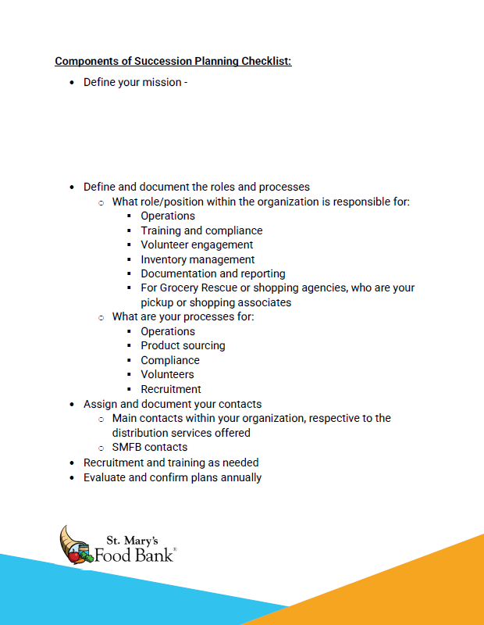
Components of Succession Planning Checklist

Slide 9
Icebreaker
In your previous group:
If your organization does not have a current Succession Plan, would it be beneficial to implement one?

Slide 10
What Happens If………
Main program contacts are unavailable due to:
Short or long-term leave
Illness or medical issues
Resignation
Site issues
Power loss
Volunteer issue, impacting ability to operate distribution(s)
Product pickup or delivery cancellations or delays

Slide 11
What Are The Duties of Programming?
Which are critical to operations?
Consider day-to-day vs. infrequent duties
Opening/closing
Food orders/deliveries
Inventory control
Volunteer management
Board engagement (if applicable)
Donor engagement (if applicable)
Distribution and intake
Reporting

Slide 12
Documenting Job Descriptions
Remember: One person SHOULD NOT HAVE to do it all
Why do we need to document?
Allows for a smooth transition for back up when needed
The more your staff/volunteers (when applicable) understand about your operations and partnerships, the more success you will have

Slide 13
Job Descriptions Worksheet
Position title
Duties
Outcomes of this role
Skills needed
Attitudes/other qualities needed
Time required
Motivation for this role
Resources needed

Slide 14
Icebreaker
In your previous group:
Have you experienced a “What If” moment within your organization's leadership, if so, how did that go?

Slide 15
Standard Operating Procedure (SOP)
Creating a Standard Operating Procedure (SOP)
Outline
Duties
Operations
Contacts
Delivery/pick up schedule
Product ordering (if applicable)
Compliance
Program based requirements
Processes for complaints
Food recalls

Slide 16
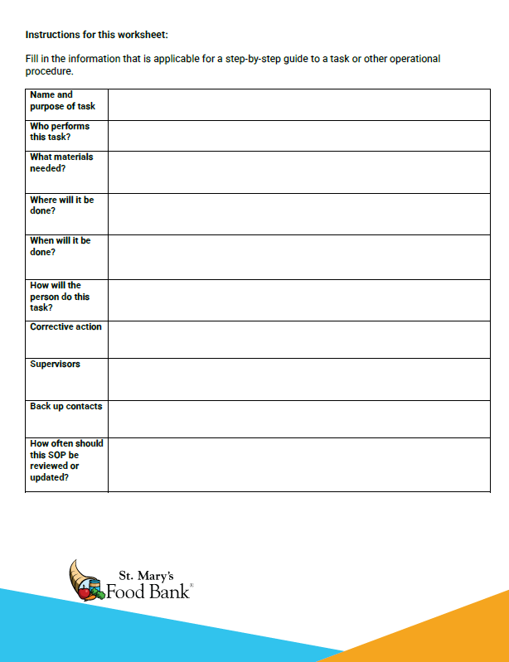
Standard Operating Procedure (SOP) Form

Slide 17
Benefits of Having SOP’s
May limit liability issues in the future
Increases compliance
Creates consistency in operations
Outlines corrective action processes

Slide 18
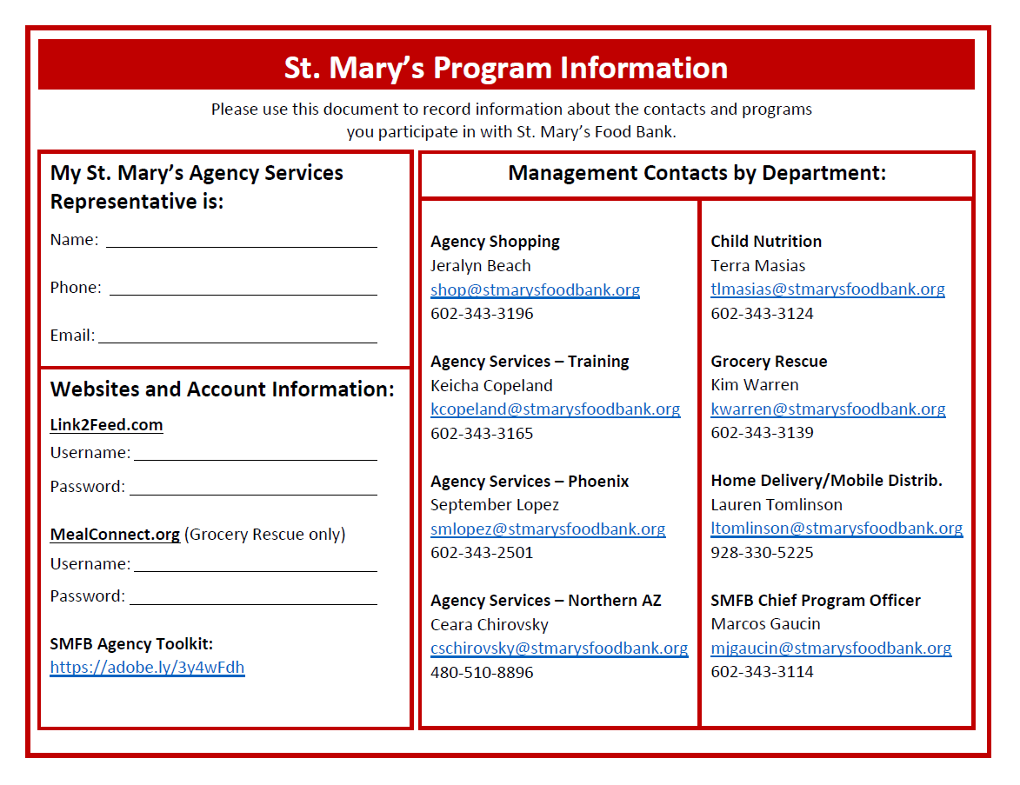
SMFB Program Information Sheet

Slide 19
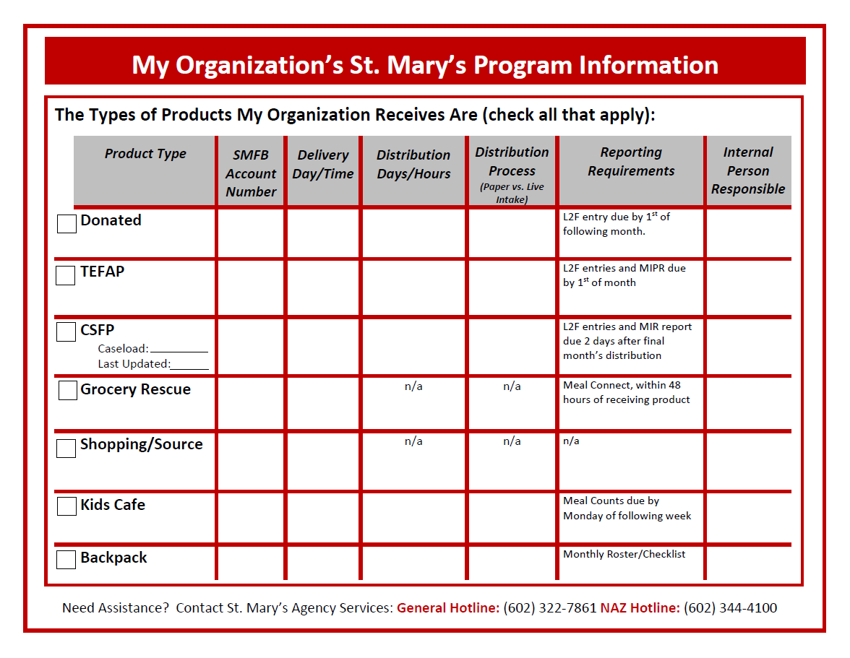
SMFB Program Information Sheet

Slide 20
What Is Next?
Meet with your team and complete:
Components of Succession Planning Checklist
Job description document
Program Information sheet
Create a plan for keeping the above up to date
Optional: Follow up invitation with SMFB’s Agency Development Lead – Isaac Orona
Would you prefer a group setting or one-on-one?
Questions?

Slide 21
Resources
Sheda, J. (2022). Succession Planning Documentation Workshop & Workbook.
Network Services, Feeding America National Organization.

Slide 22
Thank You!

