Slide 1
Welcome!
Intro to Fundraising:
2 Truths and... Another Truth

Slide 2
Truth Number One
To fundraise well, you have to manage data
Donor Data (Individuals, Corporate, Foundation)
Volunteers
Development Plan (including budget)
STUFF

Slide 3
Discuss: Data
Do you use a donor database?
  If so, what donor database do you use?
  If not, why not?
If you do use one, when did you start?
  What (if any) difference has it made?

Slide 4
Who is responsible for fundraising at your charity?

Slide 5
Do you have a plan?
Individuals
  Events
  Mail
  Web/email
  Stewardship
Foundations
  Grants
  Reports/Stewardship
Corporations/Businesses

Slide 6
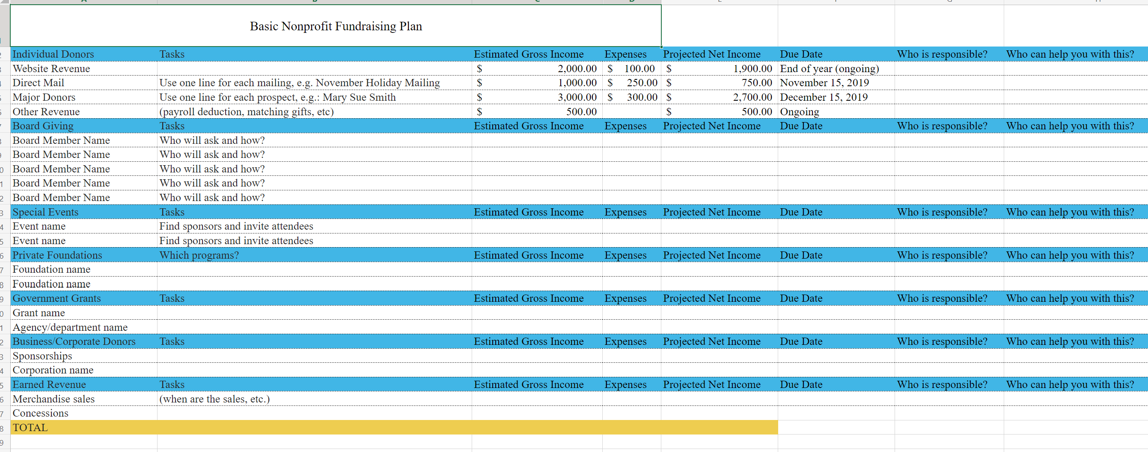
A couple examples

Slide 7
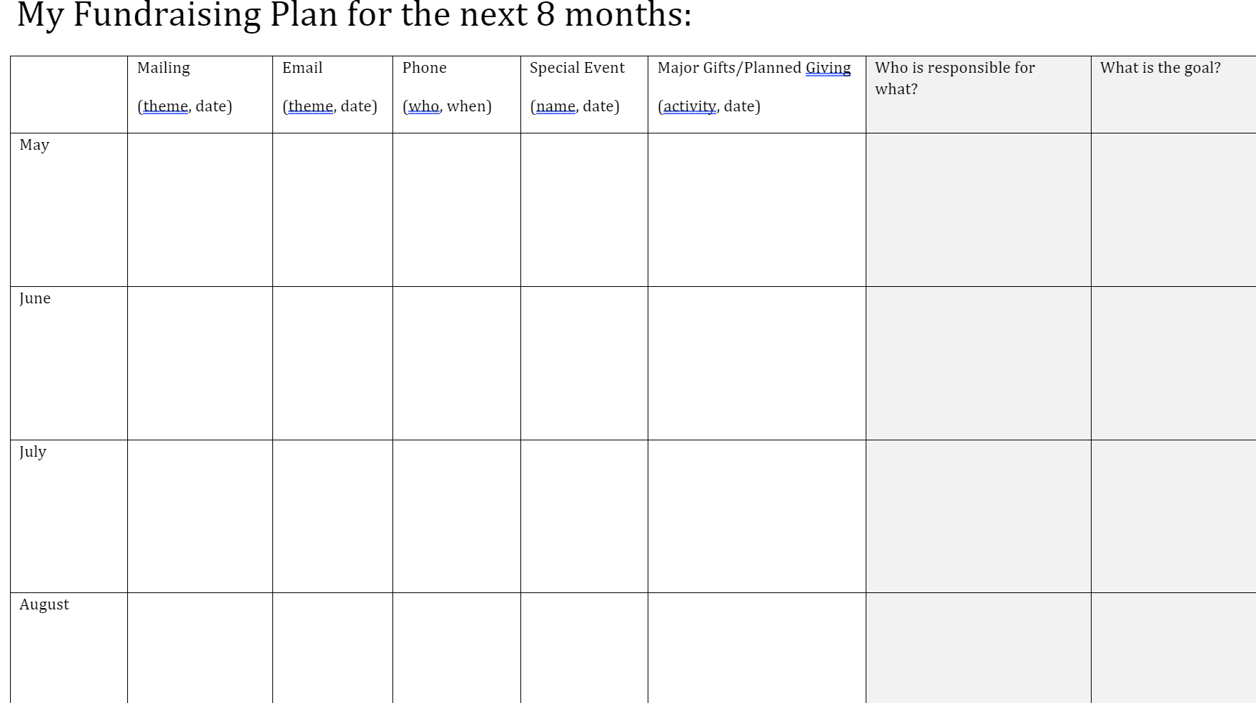
A couple examples

Slide 8
Truth Number Two
To fundraise well, you have to write, write, write

Slide 9


Slide 10
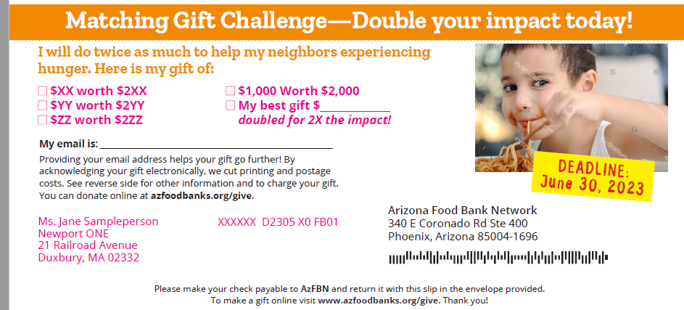
Your Direct Mail piece should have:
A Direct Mail Refresher
An outer envelope
A letter
A pre-personalized reply slip
A return envelope

Slide 11
Individuals - Web Giving
Do you have a donation form online?
If your answer to that question was no, do you know that you are wrong?

Slide 12
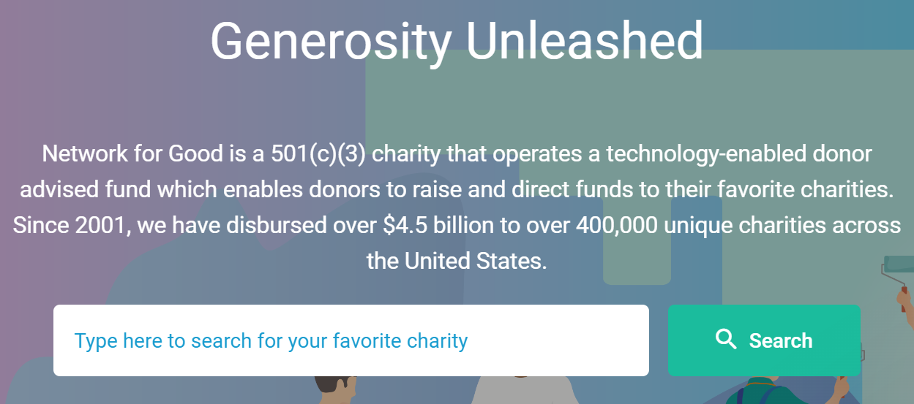
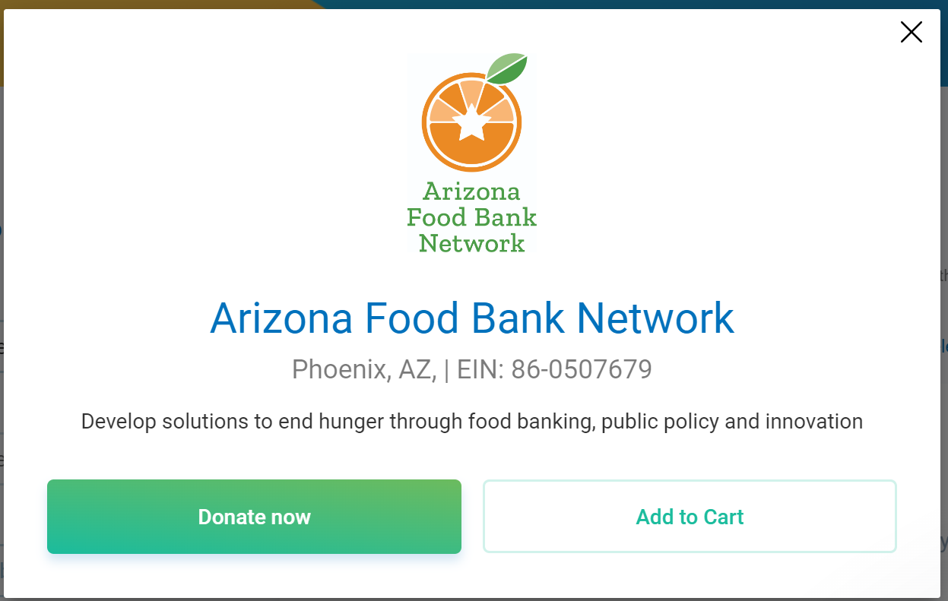
https://www.nfggive.org/home

Slide 13
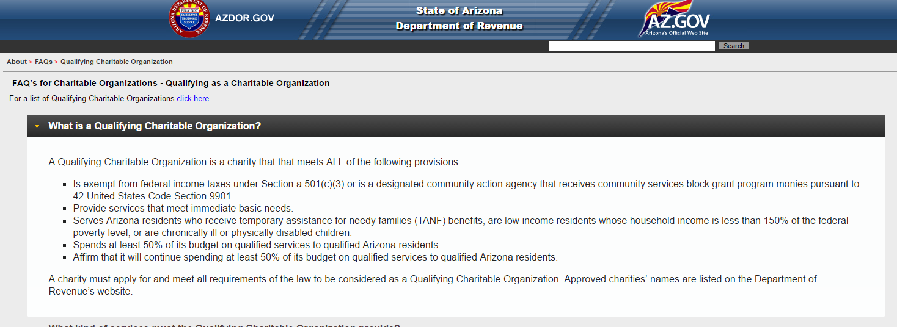
Arizona Tax Credit
https://www.azdor.gov/About/FAQs/QualifyingCharitableOrganization.aspx

Slide 14
Arizona Tax Credit
https://azdor.gov/file/9016/download?token=U3san-6s
https://azdor.gov/file/9017/download?token=1qTbA62S

Slide 15
To be a QCO, from: https://azdor.gov/tax-credits/certification-qcos-and-qfcos
Is exempt from federal income taxes under Section 501(c)(3), or is a designated community action agency that receives community services block grant program monies pursuant to 42 United States Code Section 9901.
Provides services that meet immediate basic needs, like cash assistance; medical care; childcare; food; clothing; shelter; job placement; job training services; any other reasonably necessary support to meet immediate basic needs
Serves Arizona residents who receive temporary assistance for needy families (TANF) benefits, are low income residents whose household income is less than 150 percent of the federal poverty level, or are chronically ill or physically disabled individuals.
Spends at least 50% of its budget on qualified services to qualified Arizona residents.
Affirms that it will continue spending at least 50% of its budget on qualified services to qualified Arizona residents.
If you aren’t a QCO, apply to be one today!!!
If you are, be sure to renew every year!

Slide 16
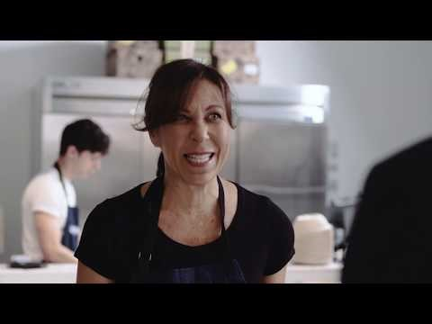
Sometimes the best writing is not going to work

Slide 17
Truth Number Three
To fundraise well, you can’t do it alone

Slide 18
And Finally…
Fundraising is not about money; it is about giving people the chance to change the world.
AJ Leon @ajleon

